Slide 1
SAS Project: Black Friday Sales Analysis
Eric Ye
Metro College of Technology
Ar Kar Min
March 22, 2021

Slide 2
Introduction/ Executive Summary
A retail company “ABC Private Limited” wants to understand their customer purchase behavior against products of different categories
550069 observations, 12 variables (7 numeric, 5 character)
Includes variables for product categories, and customer demographics and total purchase amount from last month

Slide 3
Background
The data was collected over the span of the previous month
The goal is to analyze purchase amount behavior for customers based on the variables given
To learn from past sales in order to improve and increase future sales

Slide 4
Objectives
Identify the significance of the masked variables in relation to the target variable (purchase amount)
Find variables which are most important to purchase amount
Narrow down a more select demographic that likes to purchase more to improve future sales

Slide 5
Methodology
SAS 9.4 will be used for the analysis
Process will include extracting data
Cleaning data, filling missing values, and removing outliers
Univariate, bivariate analysis
Linear regression
Proc sgplot, proc corr, proc glm, proc reg and more procedures will be used in the analysis

Slide 6
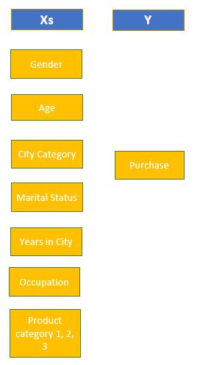
Study Framework
Independent variables: Gender, Age, City category, Marital status, Years in City, Occupation, Product Category 1, 2, and 3
Dependent Variable (Target): Purchase

Slide 7
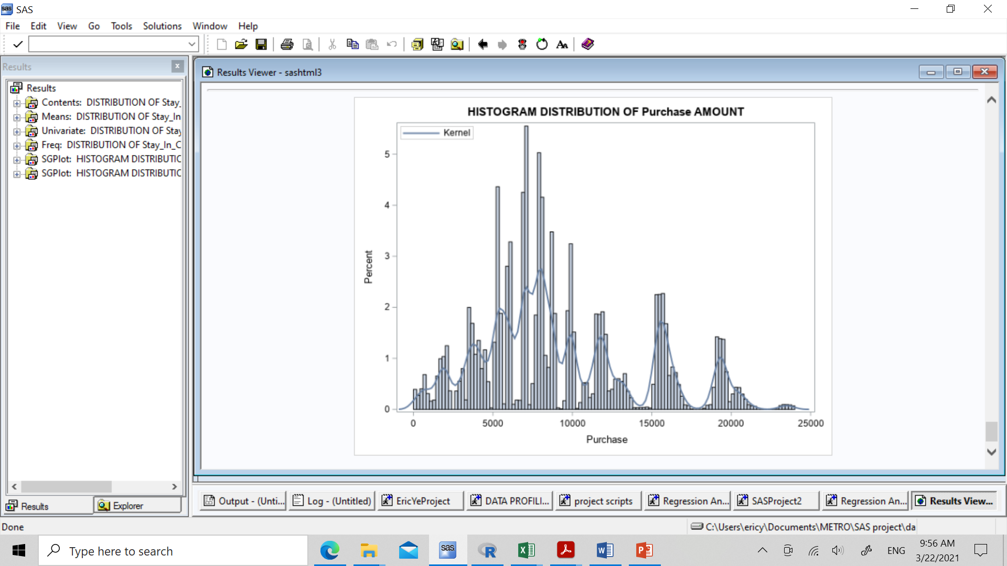
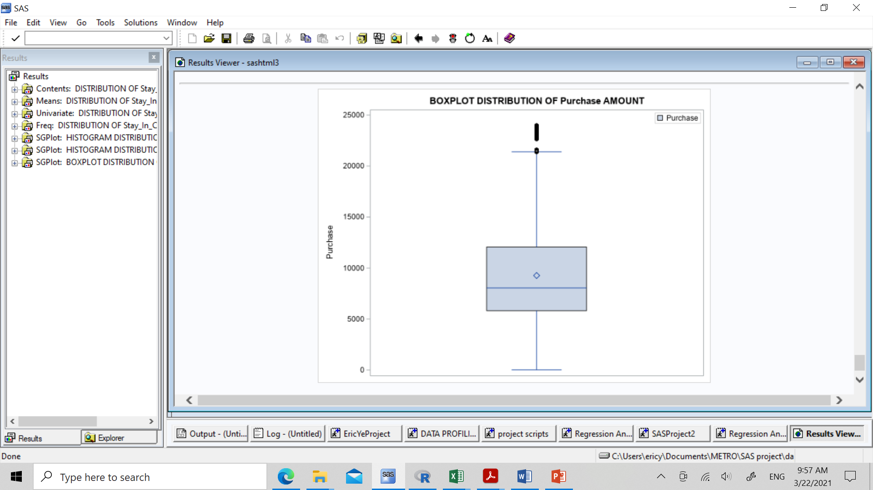
Descriptive Analysis
Data Cleaning:
-Missing value, Outlier treatment

Slide 8
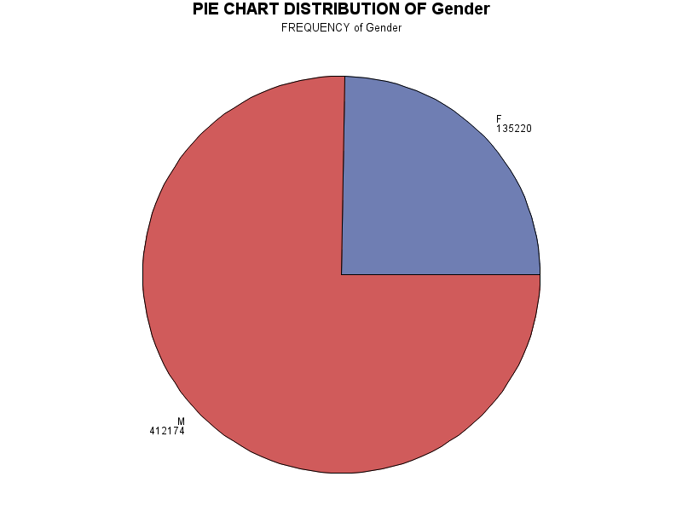
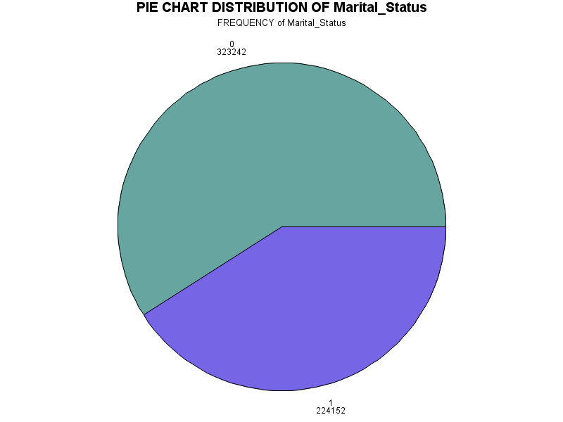
Distributions/ Univariate Analysis

Slide 9
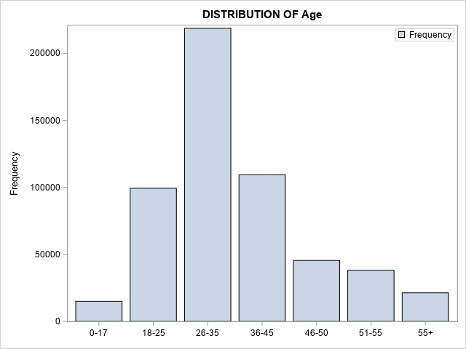
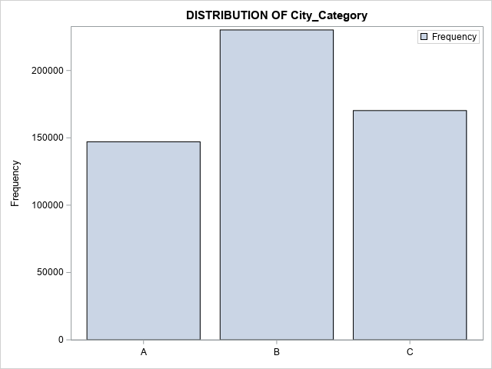
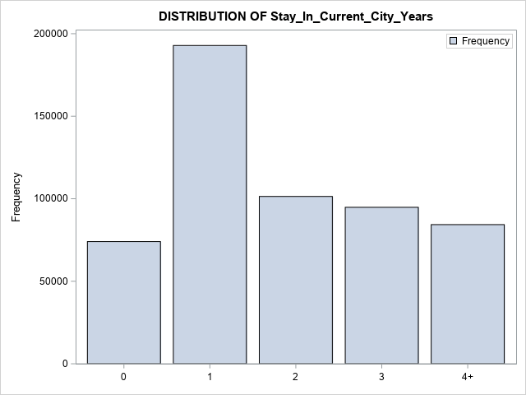
Univariate analysis

Slide 10
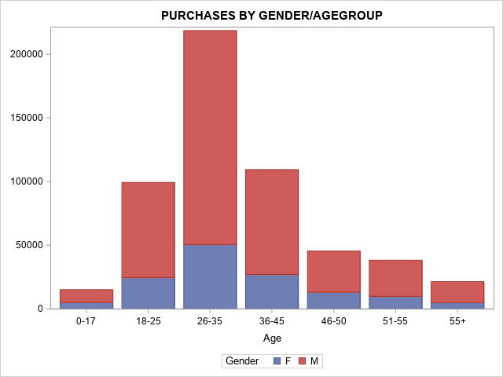
Bivariate Analysis

Slide 11
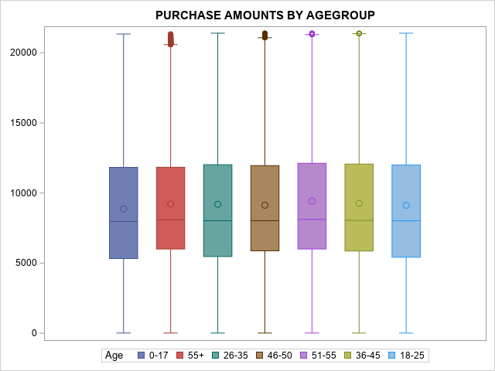

Slide 12
Hypothesis Testing
Are the product types significant to purchasing price?
When put together in a model, will they be significant?
Can purchase amount be predicted from correlating variables?

Slide 13
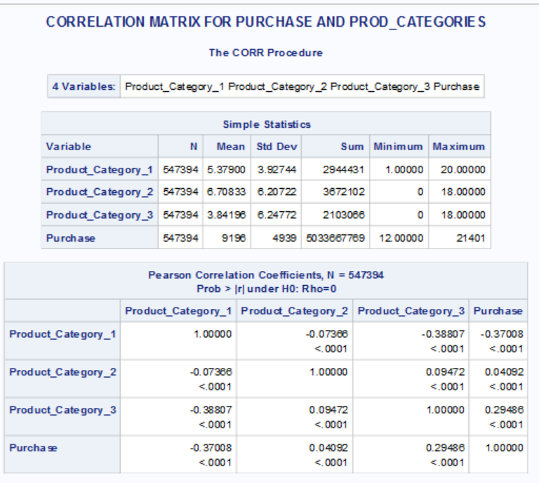

Slide 14
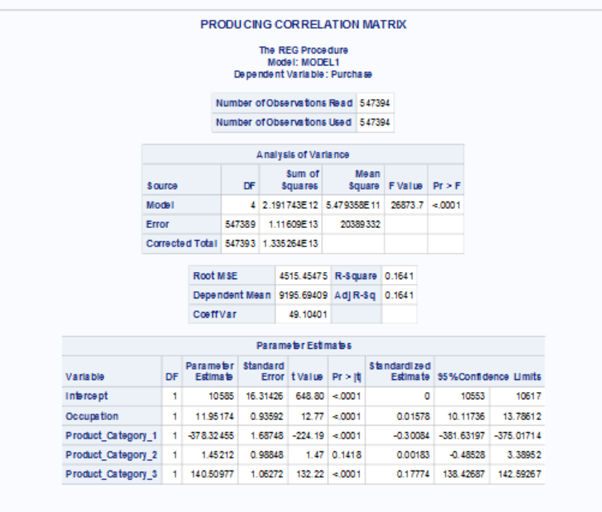
Linear regression for masked variables

Slide 15
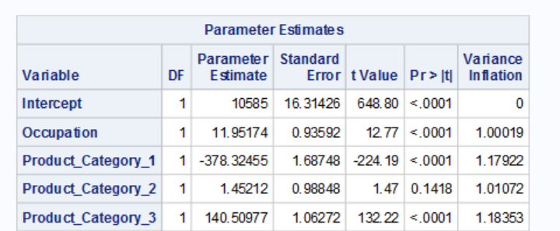
Variance Inflation Factor

Slide 16
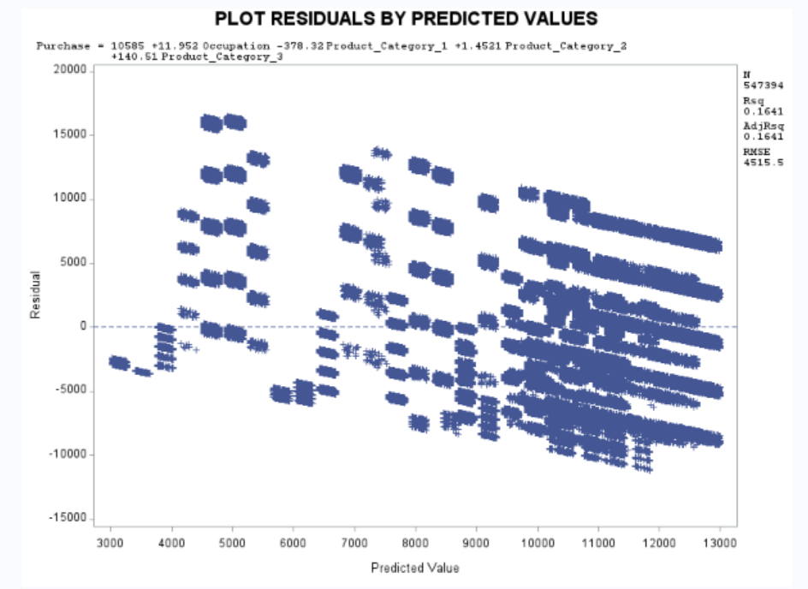
Visualize Residuals/ Formula

Slide 17
Findings/ Conclusions
Purchase amount can be roughly predicted by the masked variables of product category and occupation, where product category 1 and 3 have the most influence on it
Occupation also correlates but less strongly, category 2 seems to be insignificant
Purchase amount is not correlated with age group
There are a much higher number of purchases from men aged 26-35 than any other subgroup of people

Slide 18
Recommendations
To predict purchase amount in future Black Friday sales, focus on these variables:
Target the middle aged male audience more, reach out to them more
Focus on advertising and selling more products from categories 1 and 3
Avoid spending too much time on product category 2, it may not help sales
Try to use multiple months or even years of data for better predictions, as the dataset used was only for one month

Slide 19
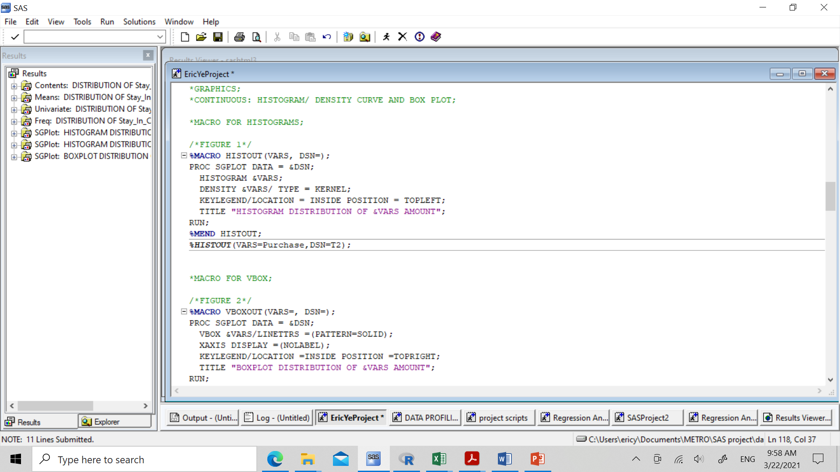
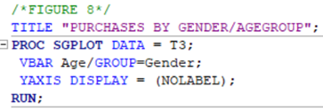
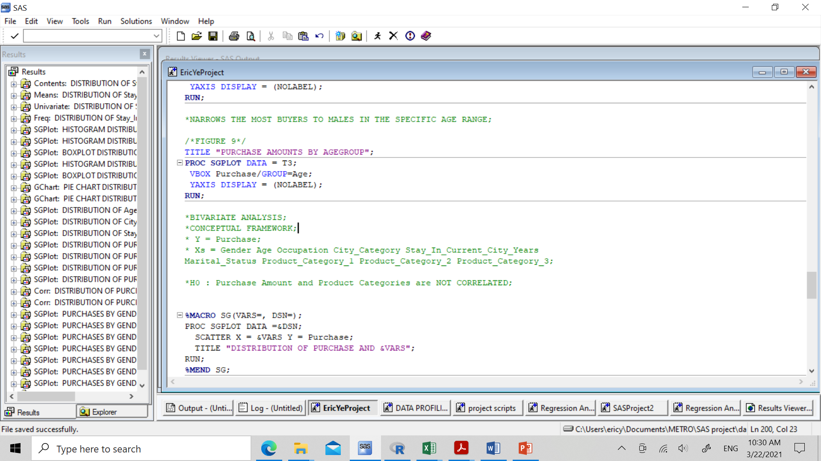
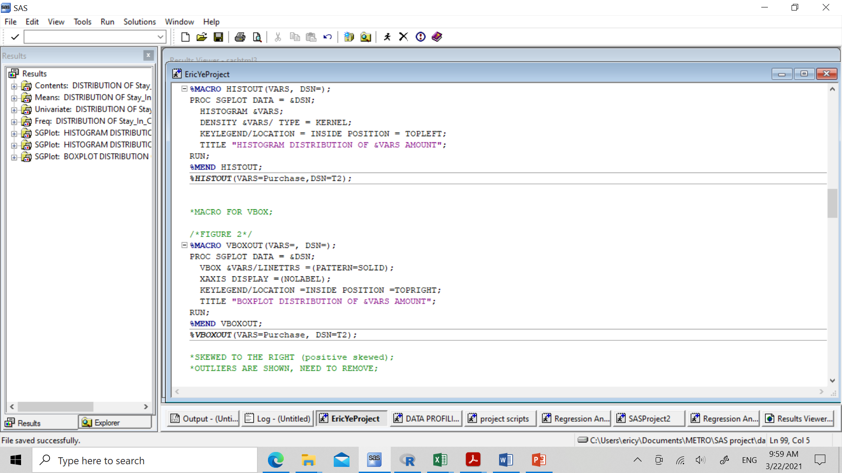
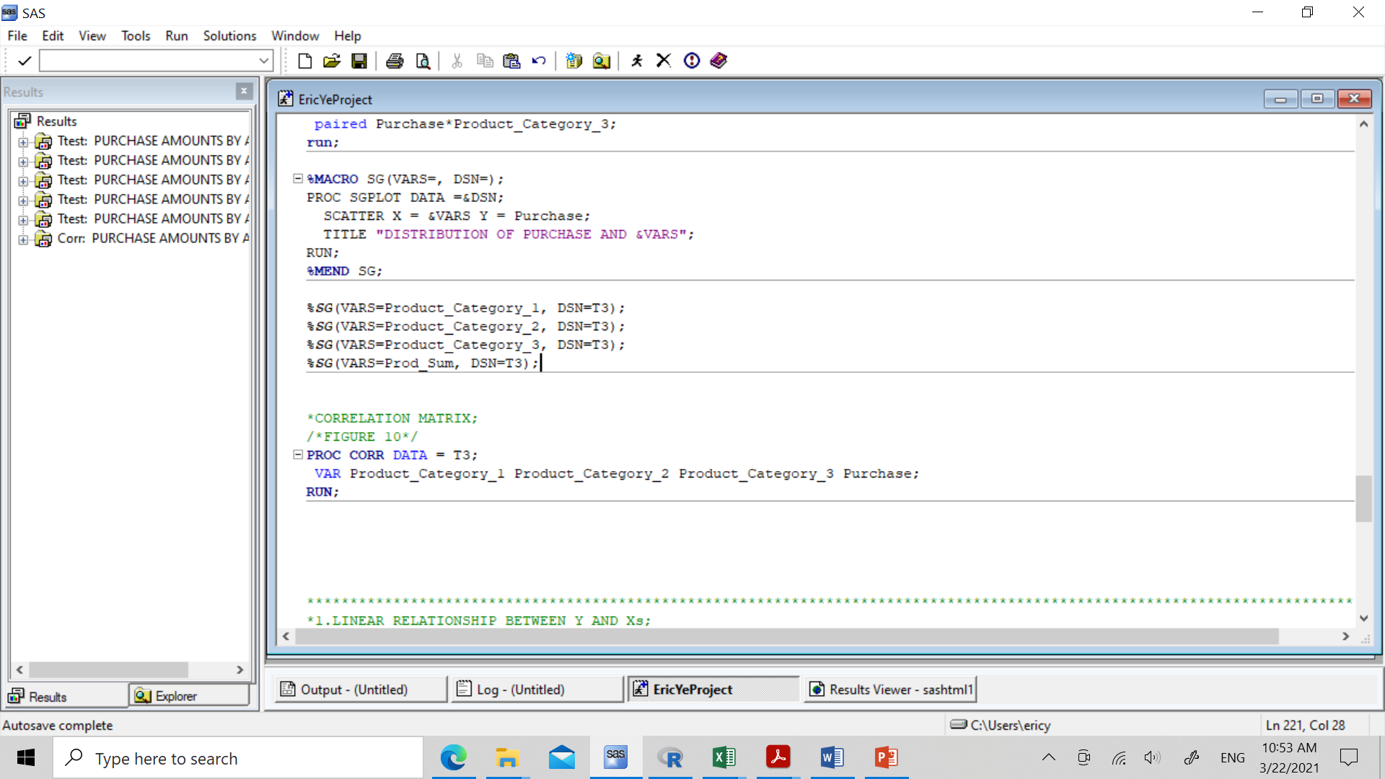
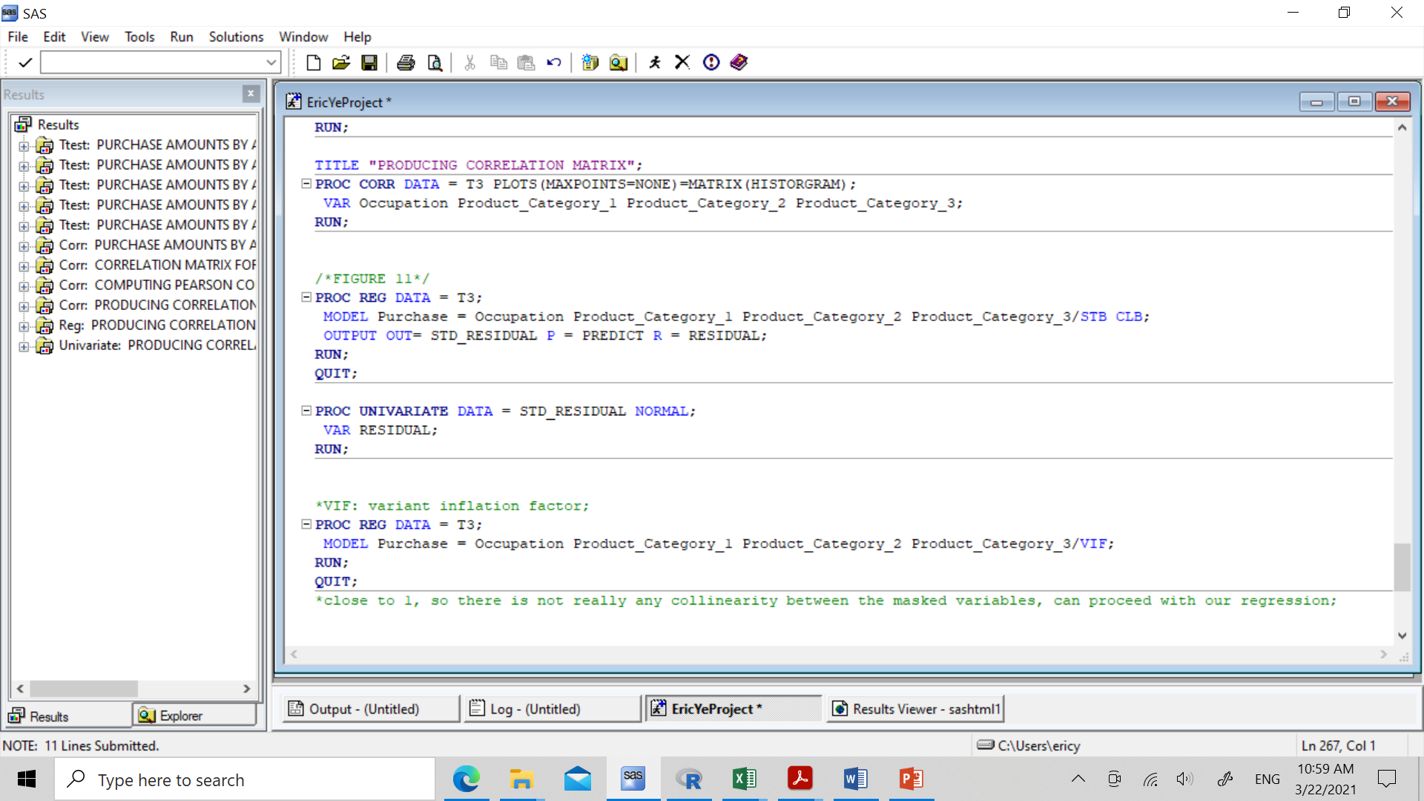
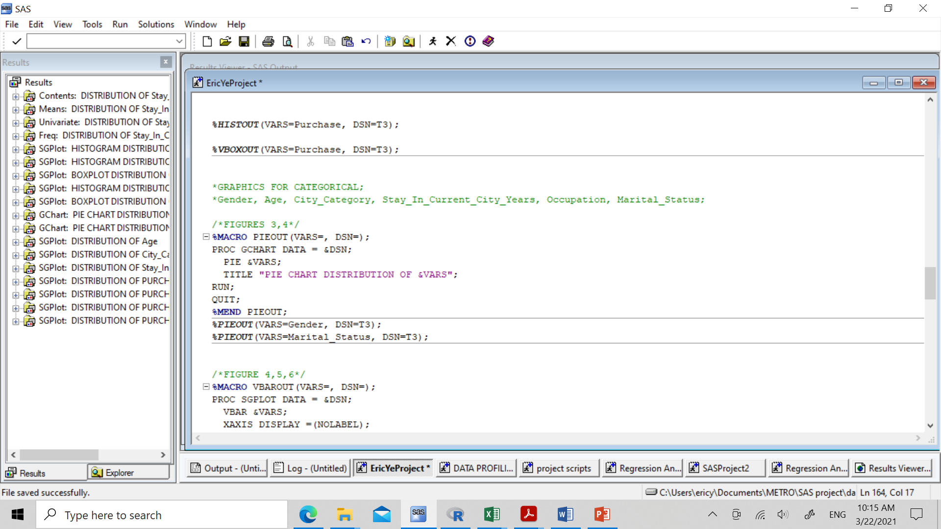
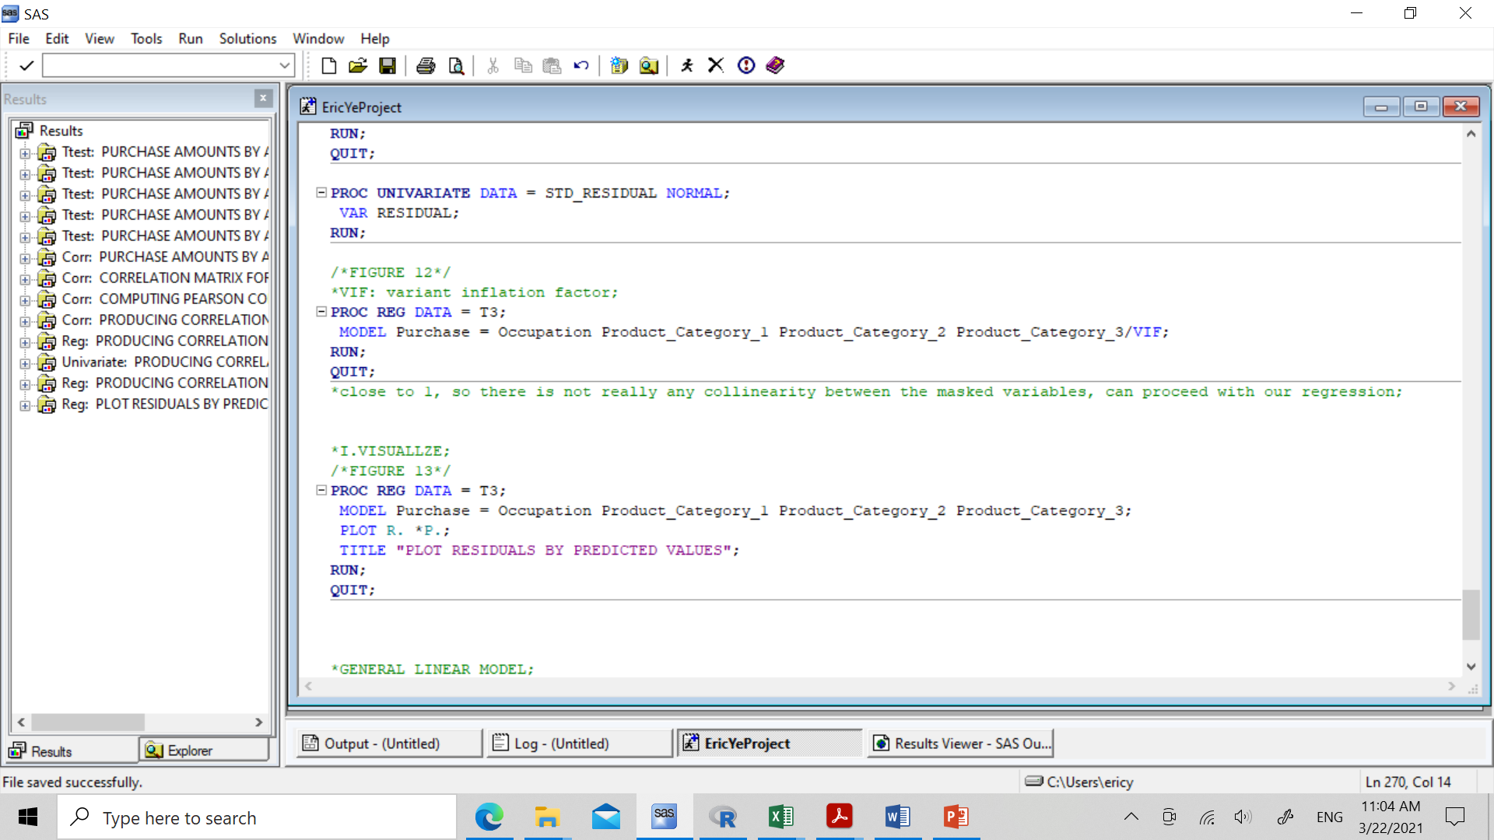
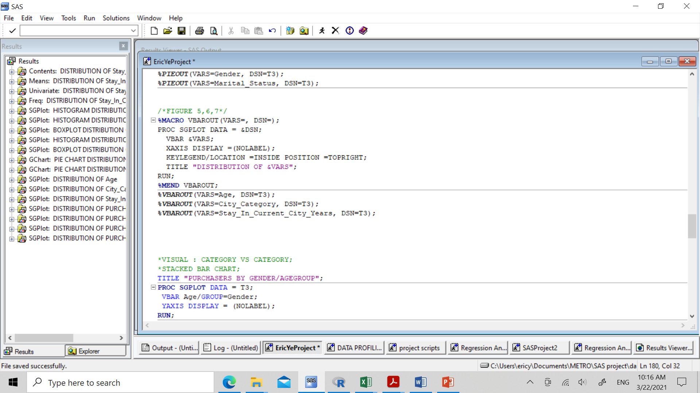
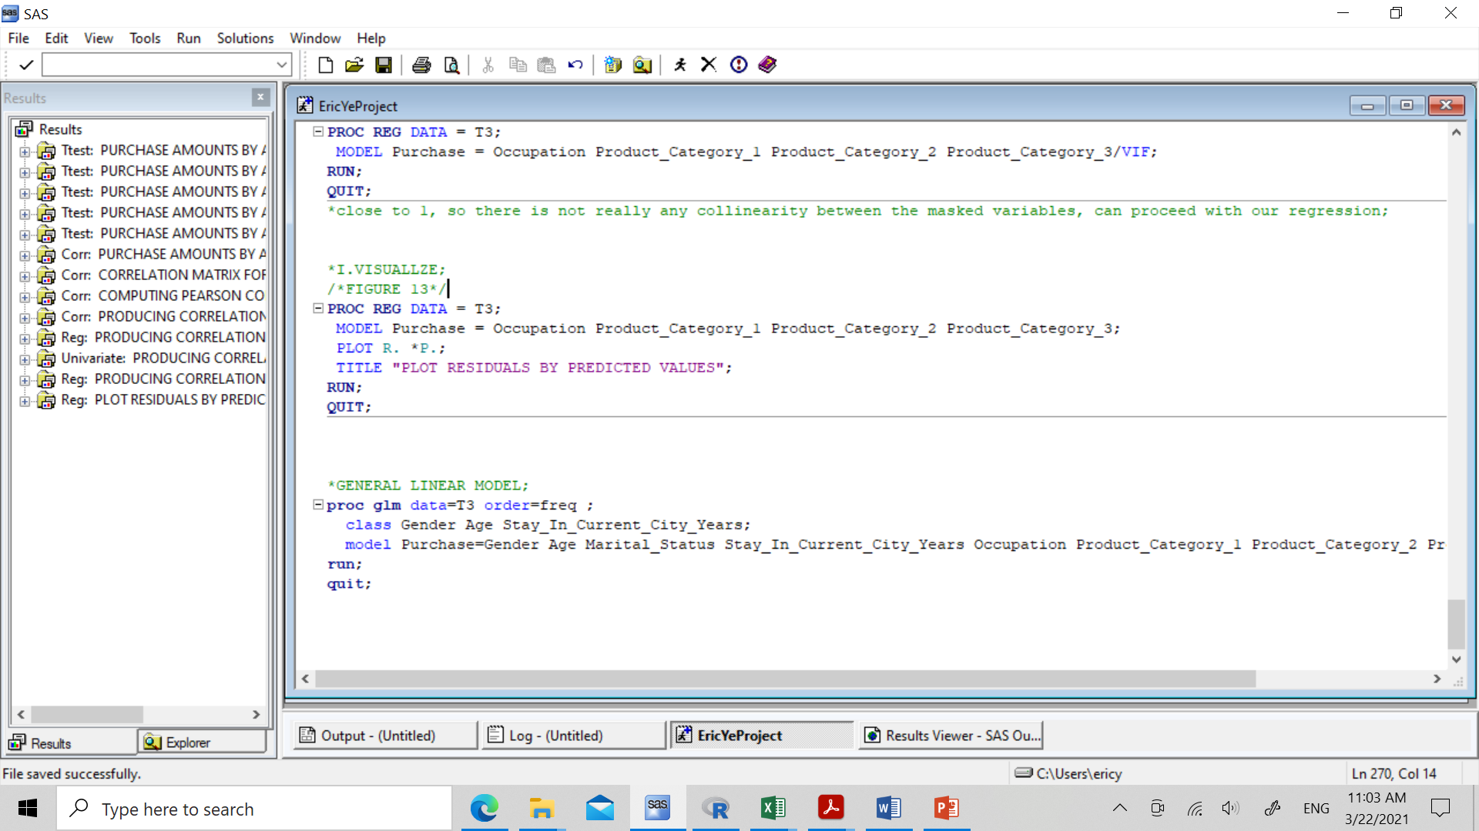
Appendix

